Slide 1
I Am Not a Robot?
Simulating Human Intelligence with Machine Learning
Adrien Porter
March 30th, 2017

Slide 2
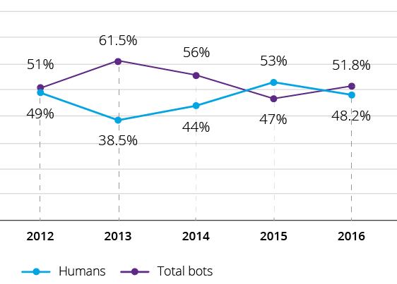
Bot Traffic Makes Up >50% of Web Traffic
Context
Problem statement
Fig.1: Bots recently have overtaken humans as the majority source of web traffic¹
Source: ¹Incapsula
Notes:
Bots serve many purposes, both benign and nefarious
Good bots: Search engine bots, commercial crawlers, feed fetchers
Bad bots: Impersonators, spammers, scrapers
Bad bots can be a drain on a website’s resources and also present security risks
DDoS attacks
Comment spam
Scraping and republishing data elsewhere
Search engine bots: help index web to optimize search (e.g. Google)
Commercial crawlers: keyword analytics on what drives traffic to website (e.g. Alexabot)
Feed fetchers: refresh FB feed on mobile
-explain bots

Slide 3
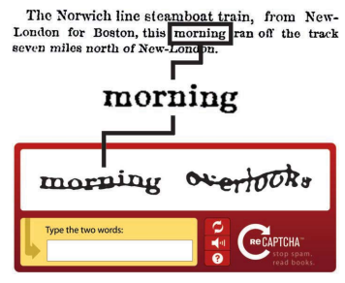
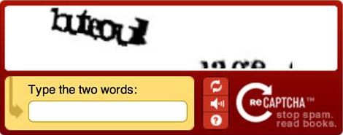
ReCAPTCHA Is Widely Used to Block Bots
CAPTCHA: Completely Automated Public Turing Test To Tell Computers and Humans Apart
Idea is to create a simple challenge to discern humans from bots…
...but can be frustrating from a UX perspective when the challenge is too difficult
Context
Problem statement
This is a frustrating experience for users
Concept...
...reality?
Source: reCAPTCHA: Human-Based Character Recognition via Web Security Measures
Notes:
Challenge must be as unintrusive and easy as possible for humans in order to preserve smooth user experience
Originally used words for transcribing text not readable by OCR (optical character recognition)

Slide 4
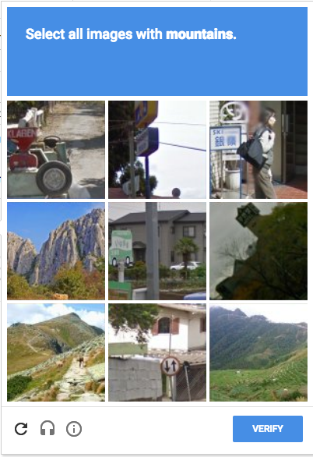
Google’s Latest Iteration Uses Context + Images
Context
Test 1: Click checkbox
Context appears to focus on browser info¹
IP address
Cookies
Browsing history
If algorithm cannot ascertain that user human, image challenge appears
Test 2: Select correct images
Source: ¹I’m not a human: Breaking the Google reCAPTCHA, Suphannee Sivakorn, Jason Polakis, and Angelos D. Keromytis
Notes:
Google’s solution….
But can a bot solve this with ML???

Slide 5
Objective
Pass ReCAPTCHA Image Challenge

Slide 6






ReCAPTCHAWiz: Selenium Integration with Convolutional Neural Network
Cloud Computing
(GPU instance)
Machine Learning
Automated Browser

Slide 7
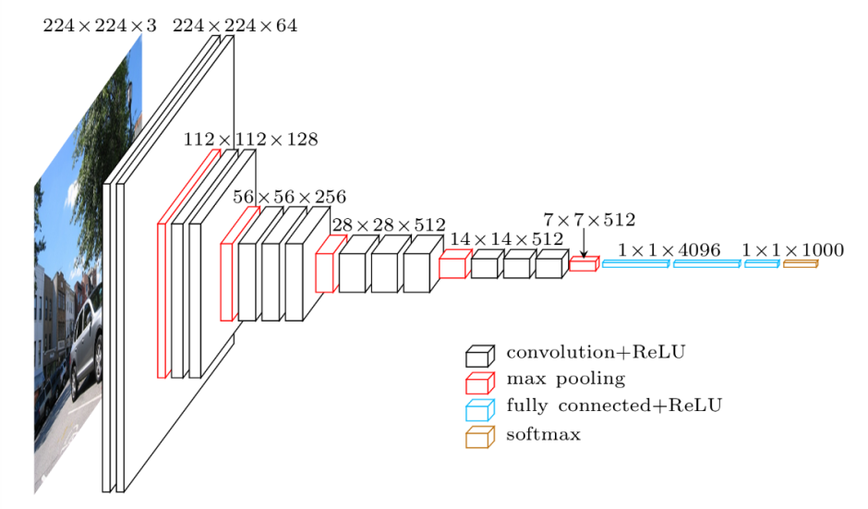
Image Classification with Pre-trained CNN
Collected over 2000 examples from “Mountain” ReCAPTCHA challenges
Mountains vs. all other (rivers, buildings, bridges, objects)
Images were pre-processed (resized and re-scaled RGB values)
98% validation accuracy in under 3 mins thanks to pre-trained model (VGG 16)
Problem statement
Removed from original and trained custom FC layer
Model Stats
Training Set | 2,000 (2 x 1000)
Validation Set | 800 (2 x 400)
Epochs | 50
Validation Accuracy | 98%
VGG 16
Architecture

Slide 8
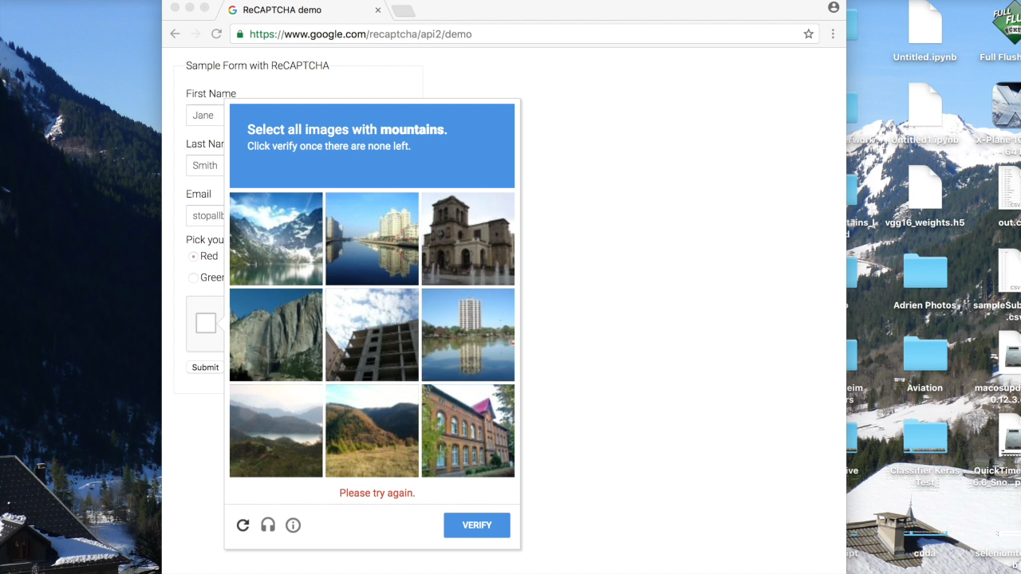
I Am a Robot...
Notes:
Make it a mountain test if other (maybe show process)

Slide 9
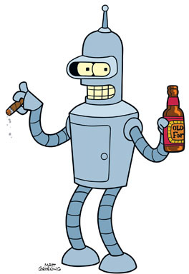
Key Takeaways
Democratization of AI will make it increasingly difficult to distinguish human activity from robot activity on the web
ReCAPTCHA may no longer be a viable solution to filter bots
The opportunity for innovation is substantial and we can expect to see significant progress in field of AI in the coming years
Notes:
Take out sub-bullets
Recently, solving this problem would have been limited to cutting-edge research…
...but today can be accomplished by off-the-shelf open source software
Once-complex problems can be easily be solved by modern machines...
...and increasingly complex tests could be a nuisance for humans
Maybe change the visual

Slide 10
Thank you.
Adrien Porter
adrien.porter@gmail.com
github.com/alporter08
linkedin.com/in/adrien-porter

